Slide 1





Computer-Assisted Collaborative Strategic Reading:
The Importance of Reading Nonfiction
In collaboration with The University of Texas at Austin
Notes:
Welcome! Thanks for being here. CA-CSR stands for Computer-Assisted Collaborative Strategic Reading, and the program will be implemented this year in my classroom.

Slide 2
Why Nonfiction?
Research shows that informational text is harder to understand and remember than stories, and teachers have reported that 44% of their students “always or nearly always” have trouble reading instructional materials (Mar et al., 2021; Shapiro et al., 2024).
Informational Text
Textbooks
More difficult to understand
Less frequently explicitly taught
Highly tested on state assessments
Often above students’ reading level​
Students already behind in reading asked to read well above their capacity
Notes:
Research shows that informational text is harder to understand and remember than stories, and teachers have reported that 44% of their students “always or nearly always” have trouble reading instructional materials.
Informational texts are often more difficult to understand, and comprehension strategies specific to nonfiction and informational text are taught less frequently than traditional fiction comprehension. Additionally, state assessments have several high-stakes items that are rooted in informational text comprehension.
We also know that textbooks historically have reading levels that are higher than students’ grade level, meaning that students who may already be behind in reading are being asked to read well above their capacity.

Slide 3
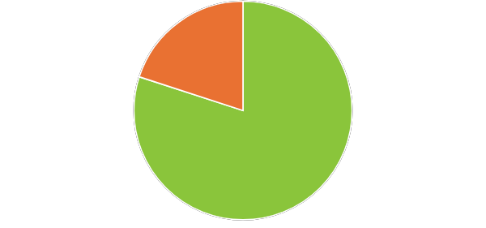
Why Focus on Comprehension of Informational and Nonfiction Texts?
There is a need for reading comprehension instruction.
Nationwide Proficiency Levels
Above Proficient
Below Proficient
Notes:
Teachers consistently report that they wish students could get a better grasp of what they are reading—specifically, in regard to nonfiction.
Recent National Assessment of Educational Progress data show that only 33% of fourth-graders could read at a proficient level (National Center for Education Statistics, 2022). These students struggle to identify the main idea, identify the meaning of vocabulary in text, or make simple inferences.

Slide 4
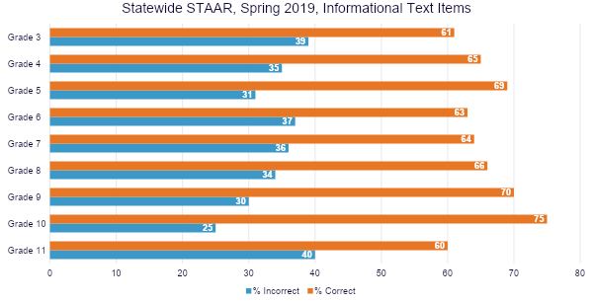
Notes:
On the STAAR test, there are about an equal number of questions about informational and narrative texts. These data represent statewide trends.
What you see here is a summary of the proportion of items correct and incorrect from only the informational text items.
Orange is correct. Blue is incorrect. So across the state, students got 39% of the questions paired with informational text wrong. There is a similar proportion all the way through high school.
Building in more opportunities for students to read informational texts is crucial, and engaging in reading at home is a great routine to establish!

Slide 5
Why Read at Home?
At-home engagement improves literacy outcomes.
Students feel encouraged to read more frequently when supported by their teachers and parents.
Helping your child choose the right book regarding interest and reading level boosts reading frequency.
Of course, if your child feels confident, they tend to enjoy reading more.
Notes:
Research shows that students read more frequently when parents and teachers support students in choosing the right book regarding interest and reading level and make time for them to read at home (Merga, 2017). And of course, the more your child reads, the better they will get, and that in turn will boost their confidence. If your child feels confident, they tend to enjoy reading more.

Slide 6


Tips for Reading at Home
After Reading
Discuss with your child what they learned.
Ask them, “What do you think is the most important information about what you read?”
While your student is getting familiar with the CA-CSR strategies in school, you can help at home!
Before Reading
Select an informational text or book.
Preview the text together. Look at the title, subtitles, and any keywords.
Ask your child what he or she predicts they will learn from reading this book or text.
Notes:
Presenter: Read aloud

Slide 7

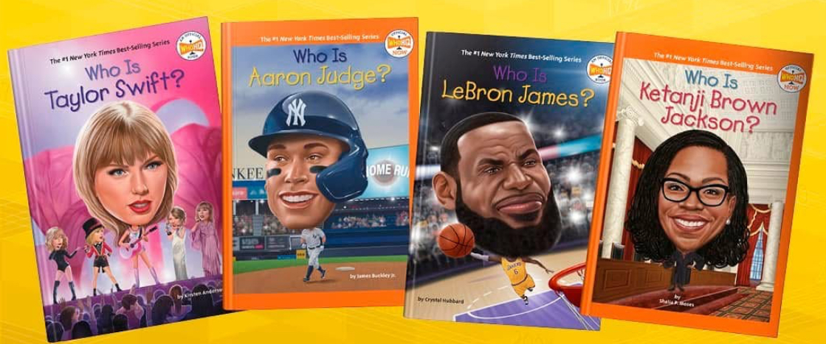
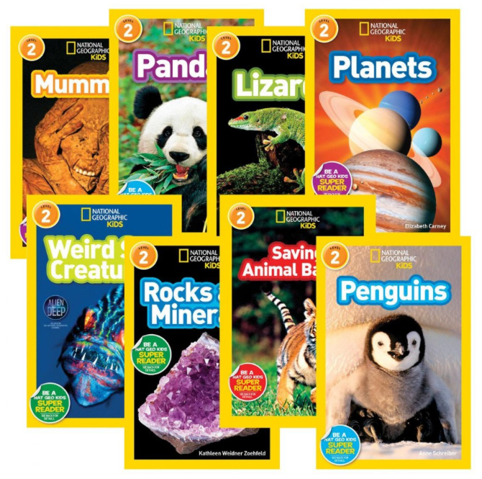
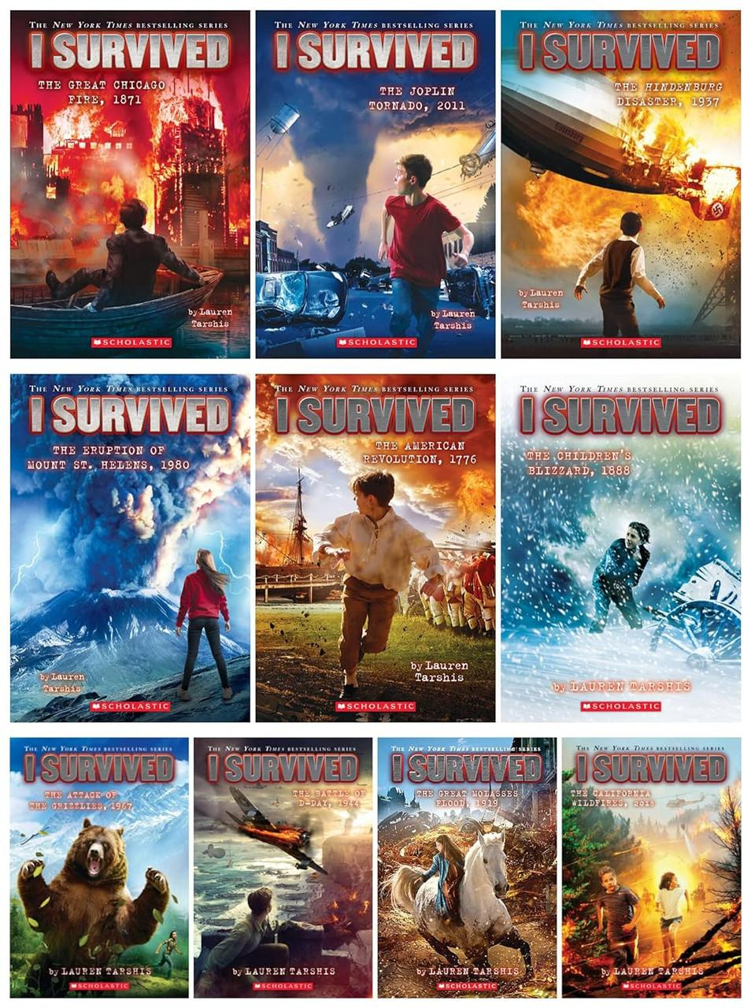
Popular in Nonfiction
Who HQ
National Geographic
Leveled Readers
I Survived
Fly Guy Presents
Notes:
Here are some popular nonfiction series!
(Verbally add any other recommendations that you know your students enjoy or are popular at your school.)

Slide 8
Thank You!
Any Questions?

Slide 9
References
Dahl-Leonard, K., Hall, C., Cho, E., Capin, C., Roberts, G. J., Kehoe, K. F., Haring, C., Peacott, D., Demchak, A. (2025). Examining the effects of family-implemented literacy interventions for school-aged children: A meta-analysis. Educational Psychology Review, 37(10). https://doi.org/10.1007/s10648-025-09985-3
Mar, R. A., Li, J., Nguyen, A. T., & Ta, C. P. (2021). Memory and comprehension of narrative versus expository texts: A meta-analysis. Psychonomic Bulletin Review, 28, 732–749.
Merga, M. K. (2017). What would make children read for pleasure more frequently? English in Education, 51(2), 207–223. https://doi.org/10.1111/eie.12143
National Center for Education Statistics. (2022). National assessment of educational progress (NAEP): Reading. https://www.nationsreportcard.gov/reading/?grade=4
Shapiro, A., Sutherland, R., & Kaufman, J. H. (2024). What’s missing from teachers’ toolkits to support student reading in grades 3–8: Findings from the RAND American teacher panel. https://www.rand.org/pubs/research_reports/RRA3358-1.html

