Slide 1

Be Our
Reading Buddy!
Tutees of Cross-Age Tutors
Notes:
Welcome to the Reading Buddies training! Today we will be learning about an exciting new part of our days in the YMCA called Reading Buddies!

Slide 2
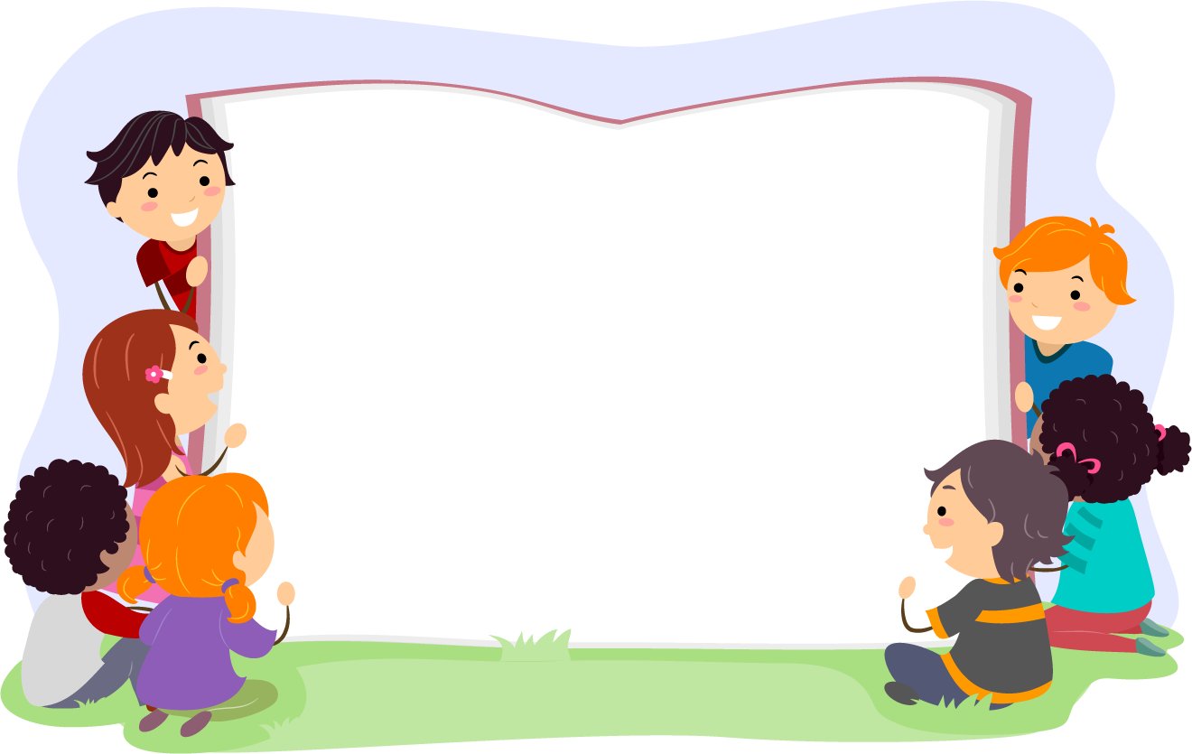
Welcome!
BEST LISTENING
Eyes to the front
Body calm
Sitting down
Voice off
Notes:
We will be learning many things today, so it is important that you are fully focused and ready to learn.
Review the best listening skills aloud.
Please show me your best first-grade full-body listening and then we’ll get started.
Wow, great job, first-graders! Thank you!

Slide 3

Sound Partners
Learn more about letters, sounds, and words!
Notes:
We will be talking about reading today. Show me a thumbs-up if you have been learning about letters, sounds, and words in school.
This year, you will also practice reading in short lessons at the YMCA using a program called Sound Partners! This program will help you learn even more about letters, sounds, and words to become rockstar readers!
You will have a reading buddy who will work with you three days a week. The great thing about this buddy is you might already know them! Your reading buddy will be an older student in our YMCA. I (your site coordinator) will assign you your buddies.

Slide 4
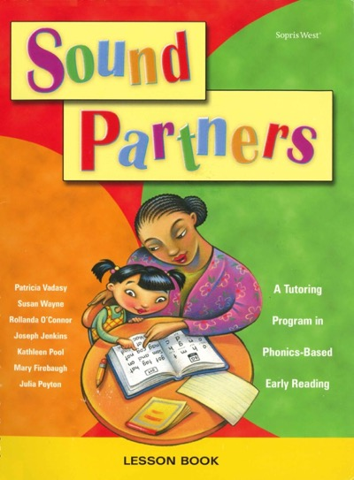
The Lesson Book
We can touch and read the book.
We cannot write or draw in it.
What are we not supposed to do in the book?
Notes:
Here is a picture of the Sound Partners lesson book. This is the book we will use each day for lessons.
We can touch this book and read from it. However, we cannot write or draw in this book. Any writing or spelling needs to be done on a whiteboard or piece of paper that we will give you.
Click for animation.
What are we not supposed to do in the book? (No writing or drawing.)
What do we use to write instead? (Paper or whiteboard.)
Good listening!

Slide 5
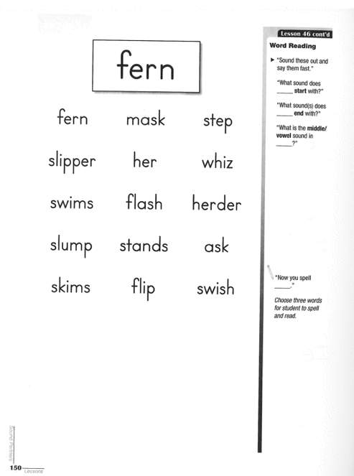
Sample Lesson
Reading
Writing
Spelling
Notes:
This is an example lesson page from the Sound Partners lesson book. Your workspace is shown here with a yellow box around it on the left side of the page.
Your reading buddy will guide you through each lesson. You will practice reading, writing, and some spelling with your reading buddy.
Click for animation.

Slide 6
Segmenting
Segmenting is when we break a word apart by its sounds.
Read the whole word.
Point to each box while saying the sounds of the word.
Sweep your finger across all the boxes and blend the whole word together.
shop
cat
dog
/c/
/d/
/sh/
/t/
/g/
/a/
/p/
/o/
/o/
Notes:
One important skill you will be practicing with your reading buddy is called Segmenting. This is when we break a word apart by its sounds. There are 3 steps to segmenting:
Read the whole word.
Point to each box while saying the sounds of the word.
Sweep your finger across all the boxes and blend the whole word together.
Remember, when we segment, we break words apart by their sounds, not their letters. Watch me segment the sounds in the word cat.
Click to animate “cat.”
Point to the word and say “cat.”
Point to each box, saying its sound: “/c/ /a/ /t/.”
Sweep your finger across all boxes from left to right and say “cat.”
Now let’s try the word dog slowly together.
Click for animation and repeat with the word dog.
Now let's try shop together. Remember that /sh/ is one sound!
Click for animation and repeat with the word shop.

Slide 7
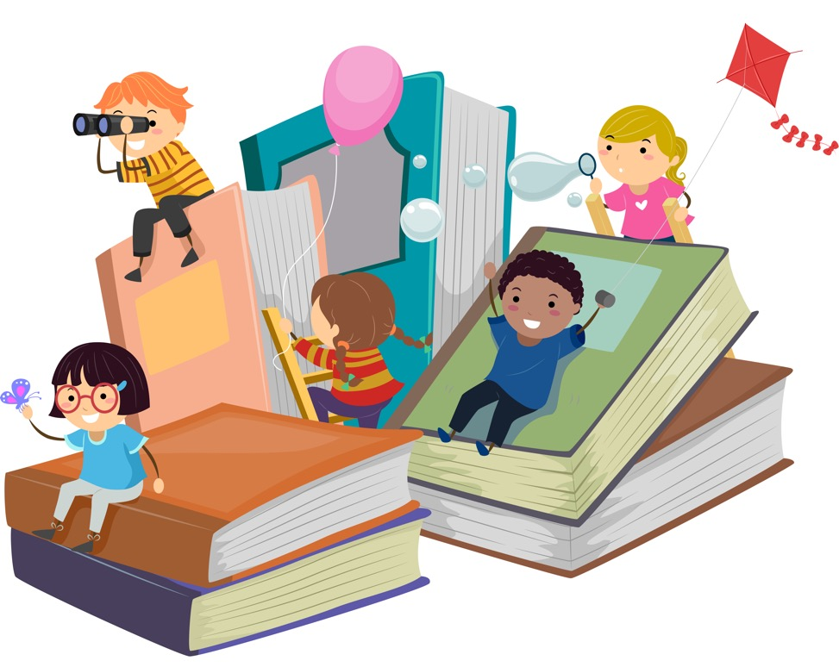
Looking Ahead
Notes:
Now, let’s look ahead to what our days as Reading Buddies will be like.

Slide 8
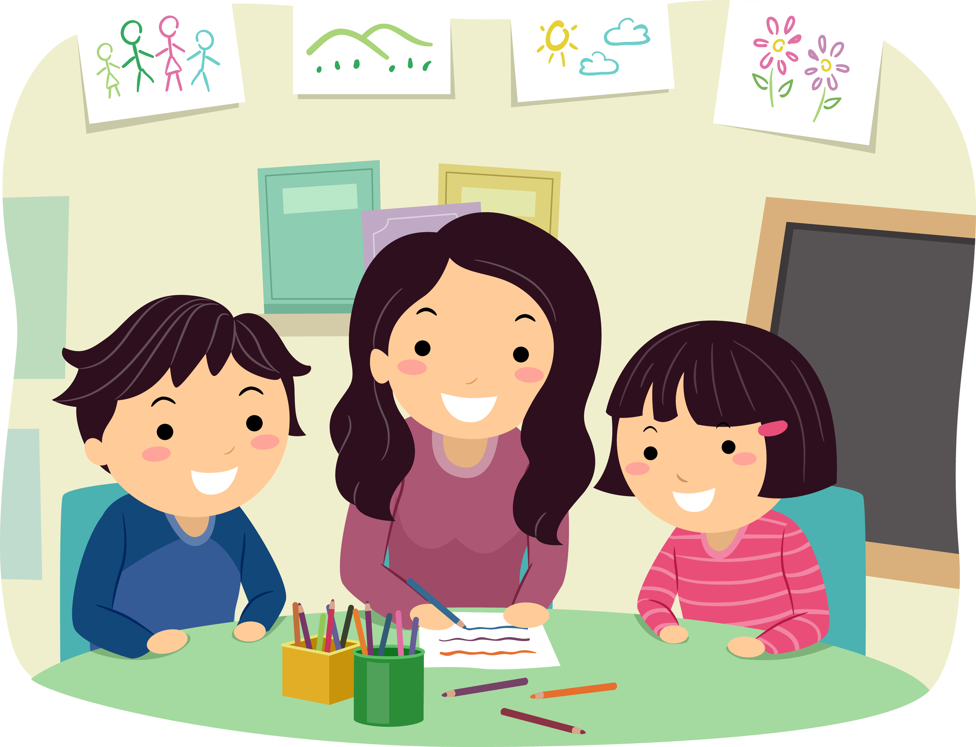
Schedule
You will meet
3 times per week
for 20 minutes.
Why should we try to come every time?
Notes:
You will be paired with a buddy in the 4th- or 5th-grade who will lead you through your lessons.
You will meet with your Reading Buddy three days per week (Tuesday, Wednesday, and Thursday).
Your lessons will be 30 minutes each.
It is very important that you come to YMCA Reading Buddies every time.
Click for animation.
Why do you think this is so important? Share ideas with a buddy nearby.
Allow a minute for discussion. Then take a few answers from the group.

Slide 9

Be the BEST Reading Buddy You Can Be!
Notes:
Now, we’re going to talk about how we can show our best, first-grade focus in our lessons.
We know learning to read can be tricky. But we also know that by being patient and practicing good learning skills, we can make learning a little easier.
Let’s look at a few of the skills that will help us in Reading Buddies!

Slide 10

Focus
Eyes on the lesson or buddy
Body calm
Sitting down
Voice at 1 or 2
0 | Silent
1 | Whisper
2 | Indoor Voice
3 | Outdoor Voice
Notes:
Focus is one of the most important skills to practice. When we focus, where are we putting our attention? (Take answers.)
That’s right, we pay attention to the lesson or to your buddy.
When we focus, is our body moving around a lot? (Take answers.)
That’s right, our body is calm.
When we focus, are we running around the room and being silly? (Take answers.)
That’s right, we’re sitting down and being respectful of ourselves and others.
When we focus on a lesson, do we use outdoor voices? (Take answers.)
That’s right, we use indoor voices. We keep our voices at a 1 or 2.
Click to animate.
What does a noise level of 1 or 2 mean? (Whisper or indoor voice. Perhaps have a student demonstrate.)
Great responses, everyone!

Slide 11
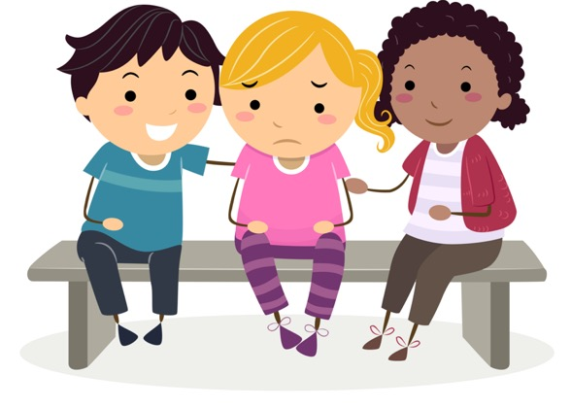
Growth Mindset
Our brains grow when we make mistakes and learn new things.
Notes:
Your brain continues to grow and learn new things, even when it feels like things are difficult or impossible. When things get frustrating, it’s important to use a growth mindset to guide you.
A growth mindset says that mistakes are part of learning. We must make some mistakes when learning a new skill like reading. Learning to read can be very tricky!
When things are difficult, should we just give up? (No.)
No. Let’s look at some things we can do instead.

Slide 12
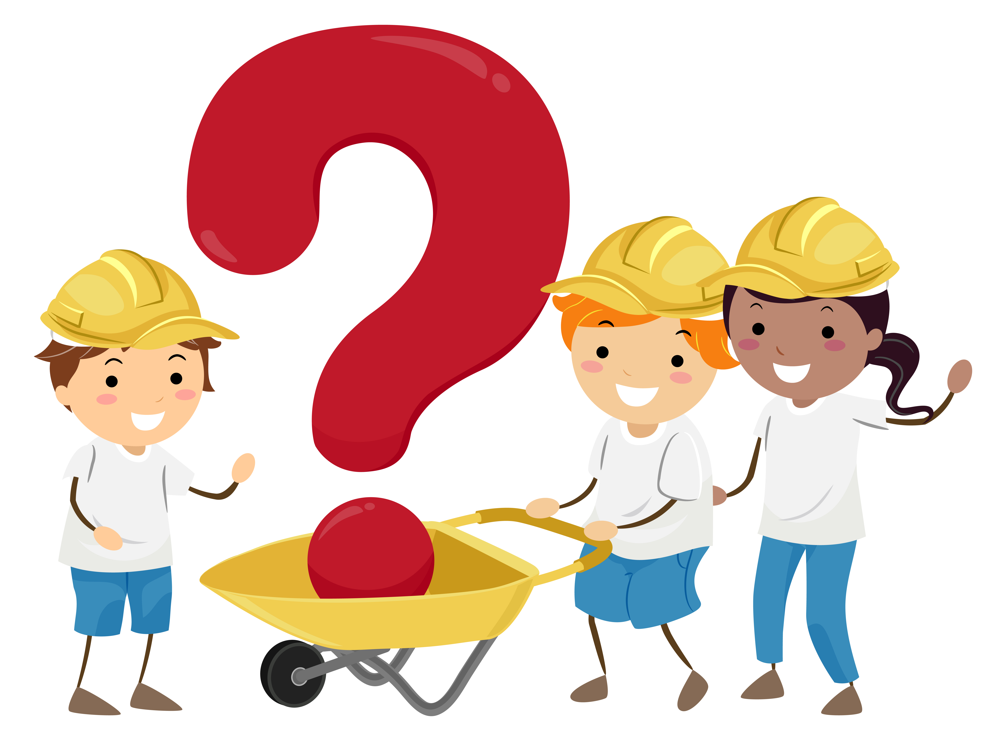
Ask for Help
What are some ways we can ask for help?
Notes:
It is normal to get stuck when you are learning to read! If you ever feel confused or frustrated, remember to ask your buddy for help!
Your buddy is here to help you, but you need to let them know how you’re feeling or that you don’t understand.
What are some ways we can ask for help? Practice asking for help from someone around you.
Allow a minute and monitor. Perhaps ask for good examples you heard.

Slide 13
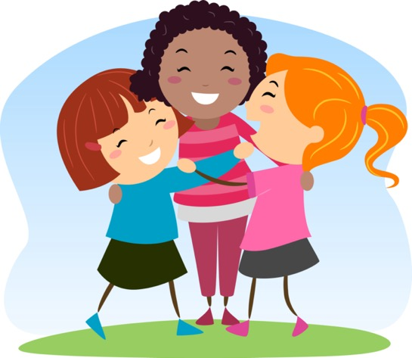
Encourage Yourself
What does it mean to encourage yourself?
“That’s okay, I can get it next time!”
"I will keep working hard!”
“I won’t give up! My brain is growing!”
Notes:
What does it mean to encourage yourself? How many of you know what the word encourage means?
Take a few ideas and examples from the group.
We learn best when we are encouraged. We can cheer ourselves on and help ourselves in a positive way!
Let’s practice doing that now. Repeat these phrases after me.
Click to animate. Read and have students repeat each phrase.

Slide 14
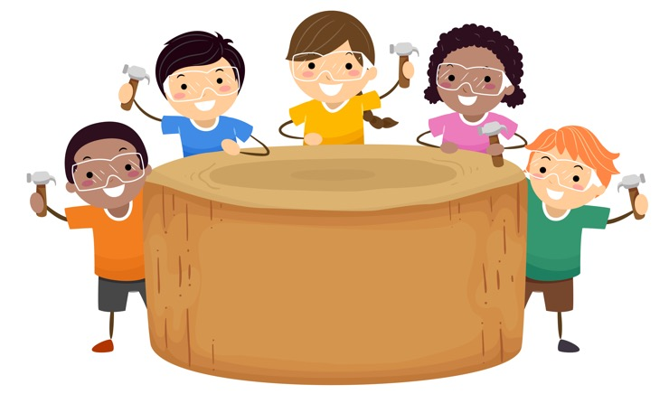
Work Hard
What does it mean to work hard?
Notes:
What does it mean to work hard? Take a moment to think about this question with someone next to you. What are some ideas that come to mind?
Allow a few minutes. Then, take a few answers from the group.
Working hard is something we want to do every day.

Slide 15
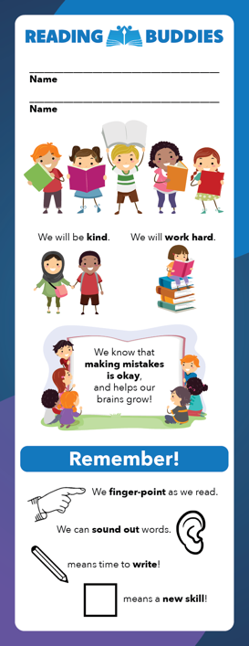
Bookmark
Notes:
In addition to the Sound Partners book, you will use 2 extra items. The first is this bookmark.
Raise your hand if you know what a bookmark is for. (Take answers.)
Click for animation.
You will use the bookmark just like a normal bookmark: to keep your place in the Sound Partners lesson book. On the first day, you will write your name on the bookmark. Your can also color the icons on the first day. It will be yours to use through the program.

Slide 16
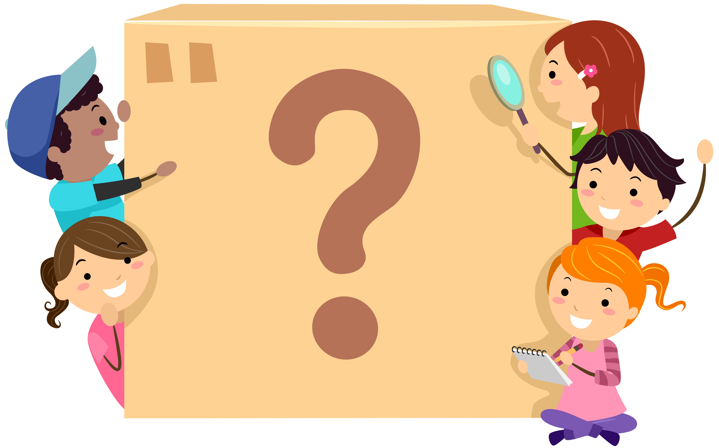
Lesson Log
Notes:
On the last page of your packet, find the Lesson Log.
You will fill out this lesson log after every day of tutoring.
Click to animate.
For every lesson you finish, you will fill in the star and then circle one of the faces to show how you felt the lesson went.
Look at the faces below the star. Let’s say you understood the lesson, you tried your best, and you and your buddies worked well together. Which of the three faces would you circle? (The first one.)
Yes, the first one. Now let’s say you sort of understood the lesson, and even though you tried your best, you felt like it could have gone better. Which face would you circle? (The second one.)
Right, the second one. Now let’s say you didn’t understand the lesson, you gave answers but everything seemed wrong, and you felt bad because you couldn’t focus or stay positive. Which face would you circle? (The third one.)
That’s right, the third one. Great work. Now, some exciting news! Do you see the yellow part at the end of the lesson log row?
Click to animate.
After finishing every 10 lessons, you and your reading buddy will get to pick a special reward from the treasure box!

Slide 17
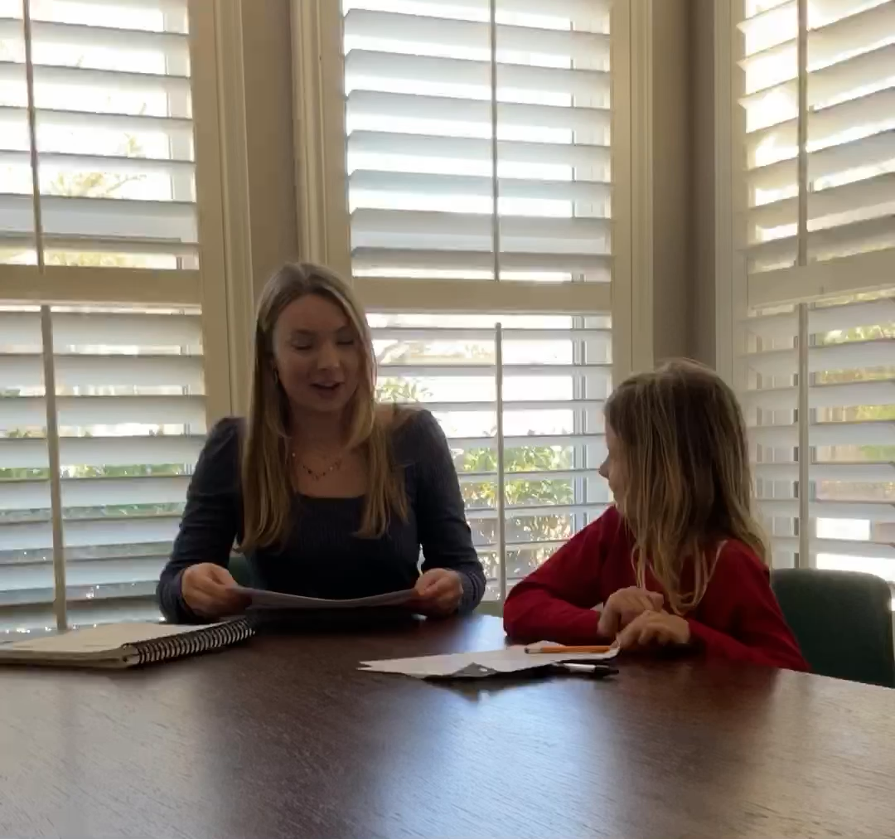
Ending the Lesson
Notes:
This video shows how you will end your lesson each day. Notice how the buddy circled how she felt about the lesson.
Click the slide to play video.

Slide 18

Questions?
Notes:
You have done a fantastic job today. You now know just about everything you need to know to become a Reading Buddy. Are there any questions?
Provide time for for questions and discussion.

Slide 19



Great job today!
Notes:
Great job again!
We look forward to having you be part of Reading Buddies here at the YMCA!
Give yourselves a hand!

